Slide 1
Hierarchical Clustering of Images
Hannah Price and Rachel Vancea

Slide 2
Problem
Want to sort picture of clothing based on color
Useful in sorting clothes by color for online shopping.
Advent of new online thrift stores, where clothing may not be tagged by color.

Slide 3
Method
Use K-means to lower dimensionality of images.
Use K-means data as basis for hierarchical clustering.

Slide 4
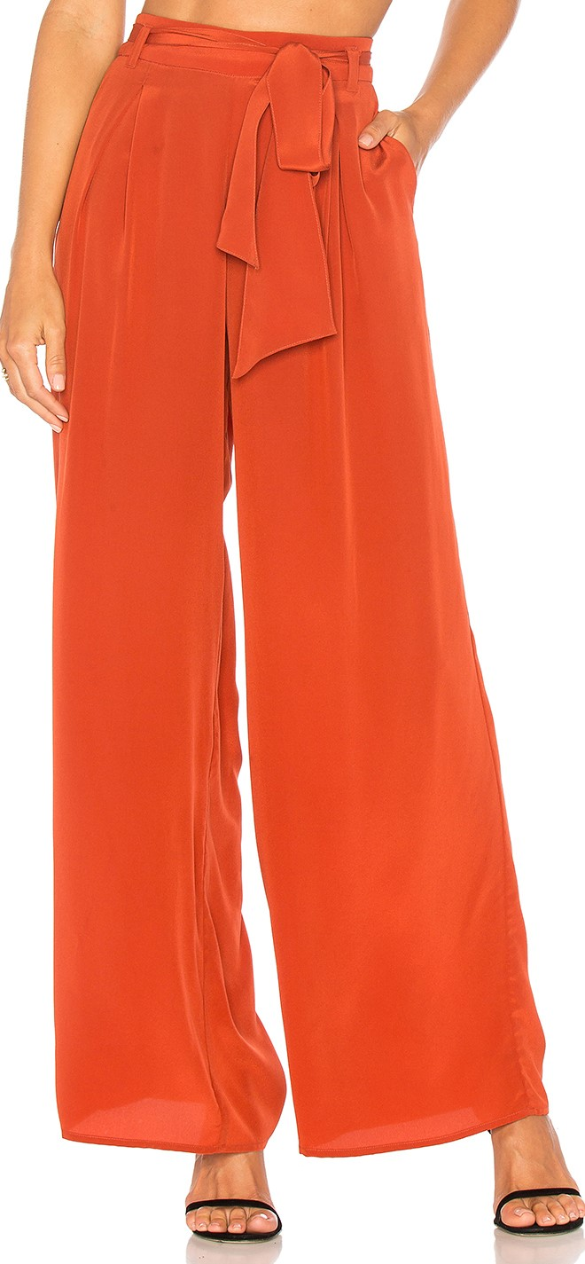
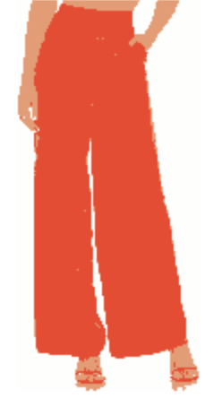
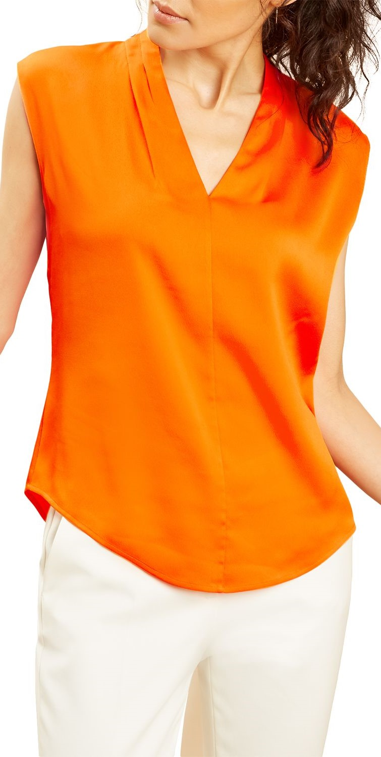


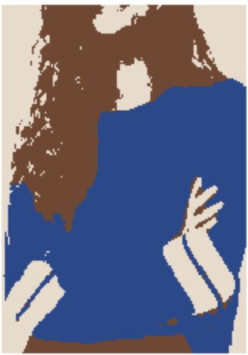
K-means Part
Use K-Means to reduce image to a few colors.

Slide 5
Distance Calculation
To prevent insignificant colors from determining the clustering, we calculate the distance based on the most to least populous colors. Then weight that dimension, based on the number of pixels of that color.
Centers: [ 41, 71, 138]
[231, 220, 203]
[111, 72, 49]
Weights: 0.47 0.23 0.28 respectively
Centers: [228, 76, 42]
[254, 254, 253]
[229, 157, 114]
Weights: 0.6, 0.32, 0.08 respectively
Distance = (weight[1]+weight[2])/2 * EuclidDist(im1,im2)

Slide 6
Hierarchical Clustering
Show tree visualization

